Slide 1
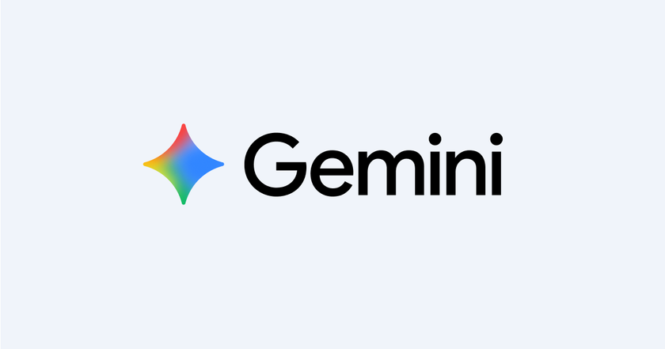
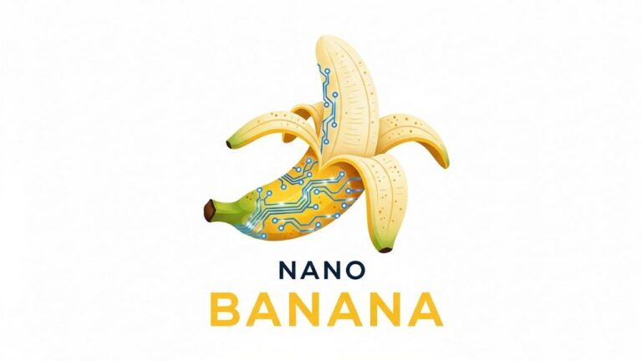
GOOGLE GEMINI
AND NANO BANANA

Slide 2

Does Artificial Intelligence think in a way similar to humans using algorithms and code, or does it truly think exactly as humans do?

Slide 3
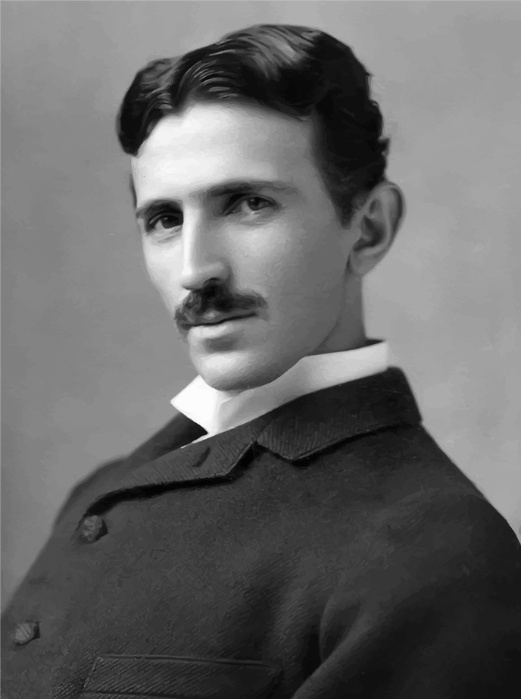
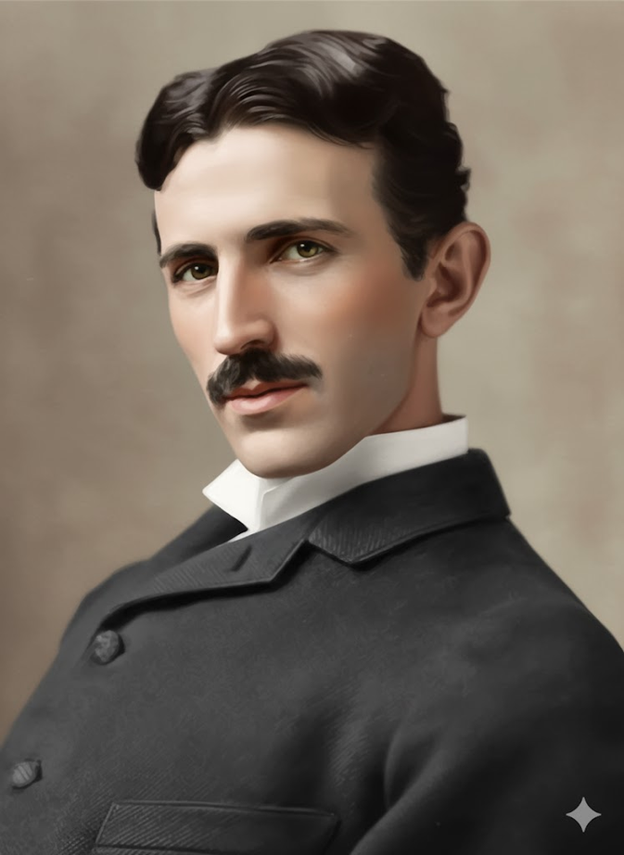
MAKE THIS IMAGE COLORFULL
OUTPUT

Slide 4
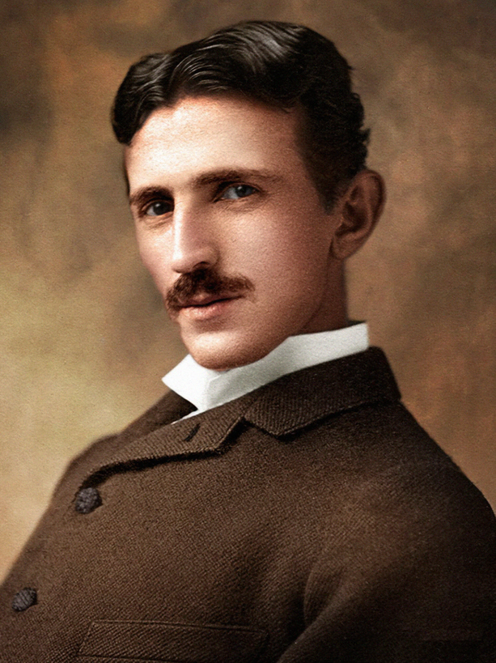
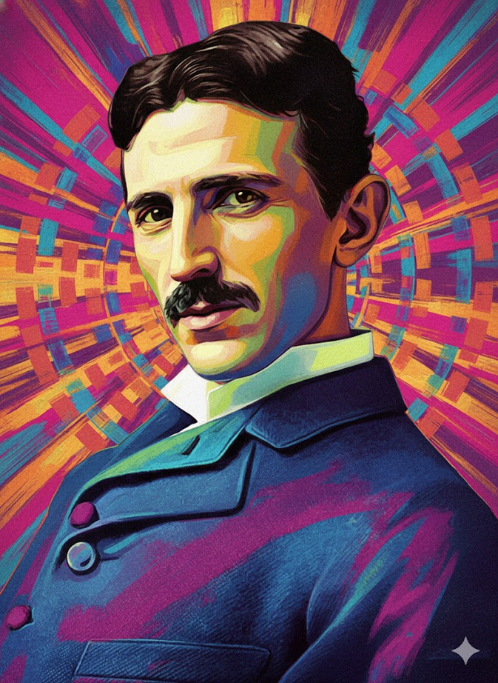
MAKE THIS IMAGE COLORFULL
OUTPUT

Slide 5
WHY NOT ?
MAKE THIS IMAGE COLORFULL
OUTPUT

Slide 6
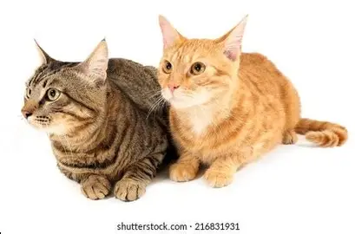
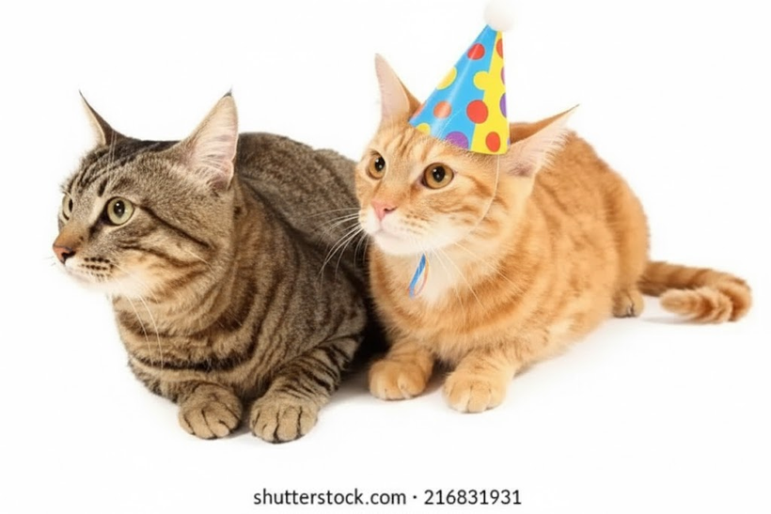
ADD AN BIRTHDAY HAT IN THE HEAD OF ONE OF THE CAT
OUTPUT

Slide 7


OUTPUT
ADD BIRTHDAY HAT IN THE HEAD OF ONE OF THE GIRL

Slide 8

REMOVE ONE GIRL FORM THIS PHOTO
OUTPUT

Slide 9
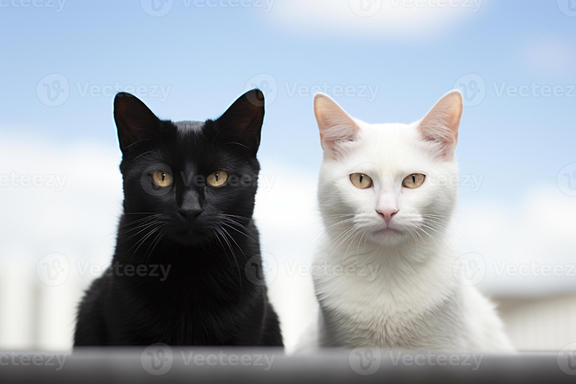
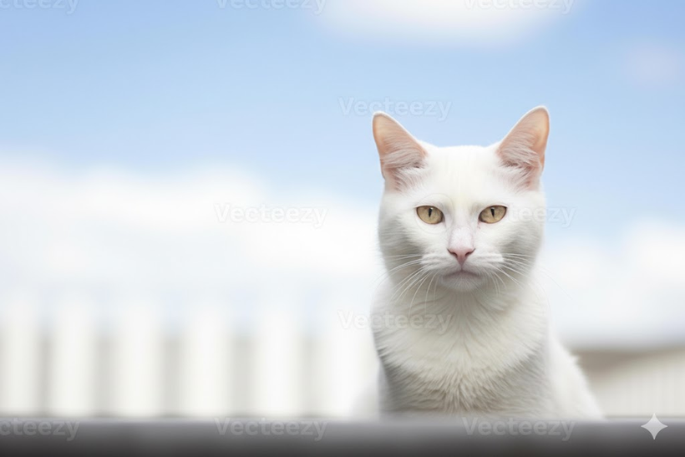
OUTPUT
REMOVE ONE OF THE CAT FROM THIS PHOTO

Slide 10
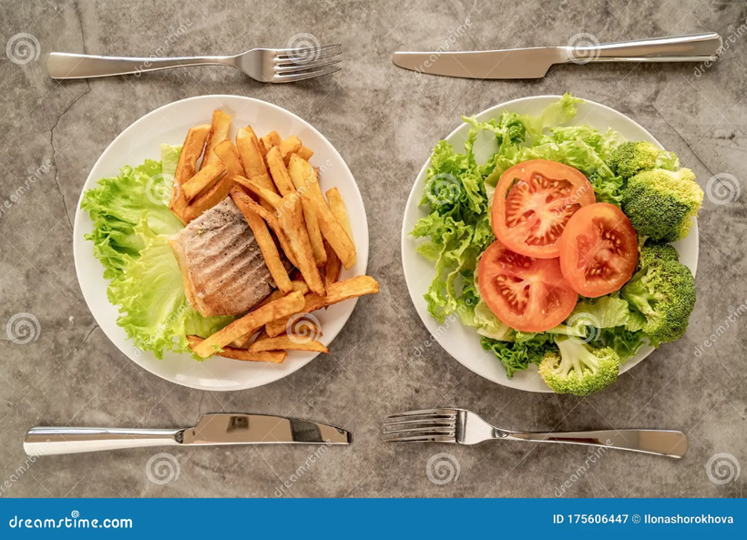

OUTPUT
REMOVE ANY ONE PLATE FORM THIS PHOTO

Slide 11


REMOVE ANY ONE PERSON FORM THIS PHOTO
OUTPUT

Slide 12


REMOVE ANY ONE PERSON FROM THIS IMAGE
OUTPUT

Slide 13
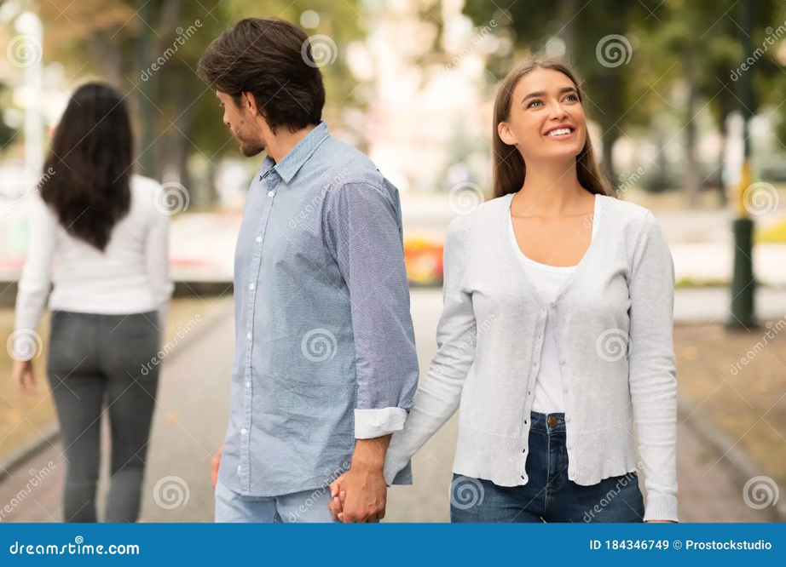
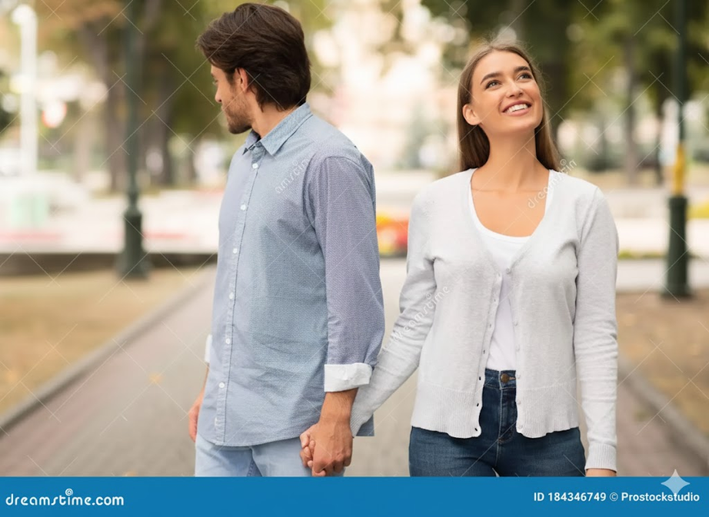
REMOVE THE BAD PERSON FORM THIS IMAGE
OUTPUT

Slide 14

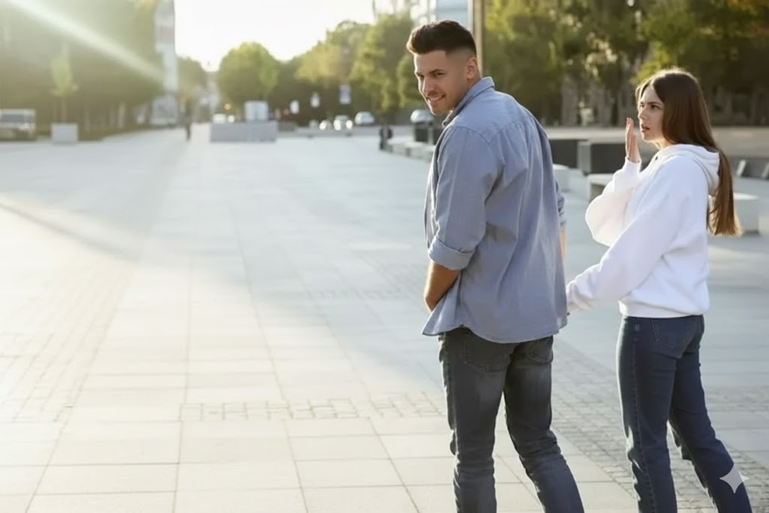
REMOVE ONE PERSON FORM THIS IMAGE
OUTPUT

Slide 15
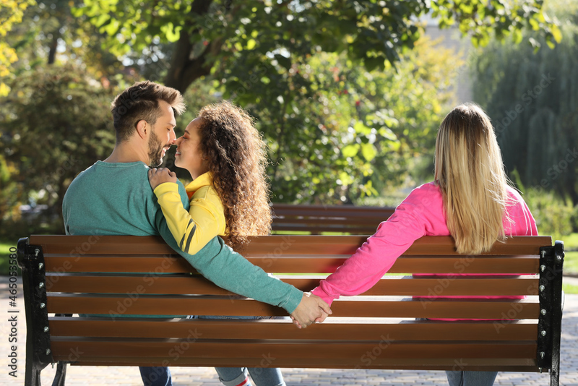
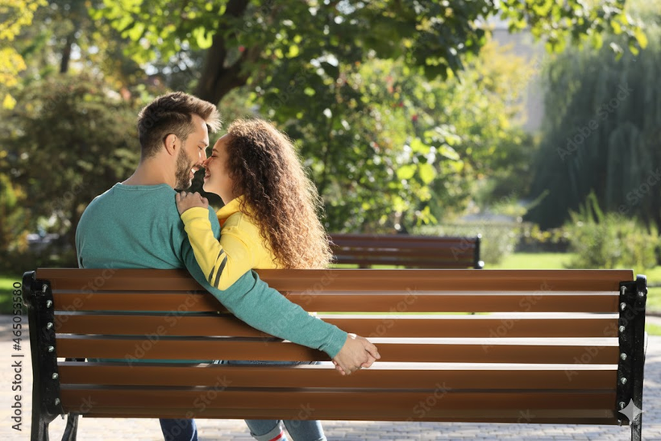
REMOVE AN PERSON FORM THIS IMAGE
OUTPUT

Slide 16
This presentation explores how AI interprets human instructions and visual context through a series of image-editing experiments. Simple prompts such as adding an object or removing a person show that AI must decide how to interpret incomplete instructions. The final experiment is more interesting: when asked to “remove the bad person,” the AI removes the girl rather than the boy. A human might identify the boy as the wrong person based on the relationship and situation shown in the image, while the AI appears to interpret the scene through visual patterns, composition, and contextual relationships. This does not mean that AI is thinking exactly like a human; rather, it shows that AI can arrive at an interpretation that is different from our own. The experiment raises an important question: when AI interprets an image, is it understanding the situation as we do, or is it finding its own interpretation based on the patterns it has learned?

Slide 17
THANK YOU

